Slide 1
Theory of Computation: CODE to implement regular expression with “pcre” library
Moo gi jun

Slide 2
Overview
Introduction to PCRE2 library
What is Regular Expression?
Programming Code

Slide 3
Introduction to PCRE2 library

Slide 4
PCRE2 Library Introduction
PCRE – Perl Compatible Regular Expressions
The PCRE library is a set of functions that implement regular expression pattern matching using the same syntax and semantics as Perl 5
PCRE has its own native API, as well as a set of wrapper functions that correspond to the POSIX regular expression API
There are two major versions of the PCRE library The newest version, PCRE2, was released in 2015

Slide 5
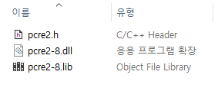
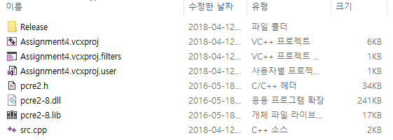
Library setup
copy 3 files (pcre2.h, pcre2-8.dll, pcre2-8.lib) into the solution directory of Visual Studio project

Slide 6
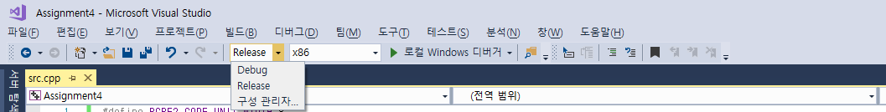
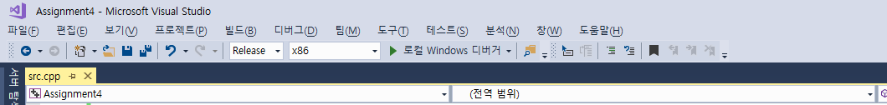
VS2017 Configuration
Please change the mode option to the release mode, not a debug mode

Slide 7
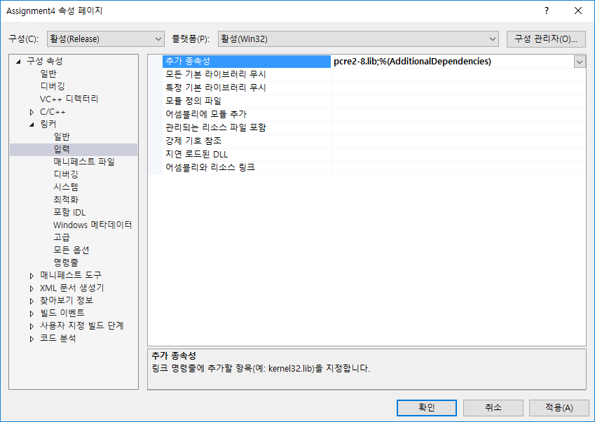
VS2017 Configuration
Go to Project Configuration Properties -> Linker -> Input -> Additional Dependencies, and add pcre2-8.lib

Slide 8
Regular Expression

Slide 9
Patterns
Reference) https://www.debuggex.com/cheatsheet/regex/pcre
Base character classes
\w – any word character. Same as [a-zA-Z0-9_]
\W – any non-word character
\s – whitespace character
\S – any non whitespace character
\d – digits. Same as [0-9]
\D – any non digit character
Quantifiers
n* – zero or more of n
n+ – one or more of n
n? – zero or one occurrences of n
{n} – n occurrences exactly
{n,} – at least n occurrences
{,m} – at most m occurrences
{n, m} – between n and m occurrences (inclusive)
Meta characters
[ – start character class definition
] – end character class definition
| – alternates, e.g., (a|b) matches a or b

Slide 10
Patterns (examples)
Examples
Pattern: \w+
String
“2016” – match
“1q2w3e4r” – match
Pattern: \d==\d
string:
“0==0” – match
“K==k” – doesn’t match
Pattern: \w{3,5}\s*\d+\w+\s\w*
String
“The 30th anniversary” – match
“Most people in the world” – doesn’t match
Pattern: [1-5][d-g]*
String
“1dfdgfdfdgfdgfgdfdfgdf” – match
“12dfdfdfdfdf” – doesn’t match
Pattern: [1]\d{1}\syears\sold
string:
“10 years old” – match
“16 years old” – match
“26 years old” – doesn’t match
“15 yearsold” – doesn’t match

Slide 11
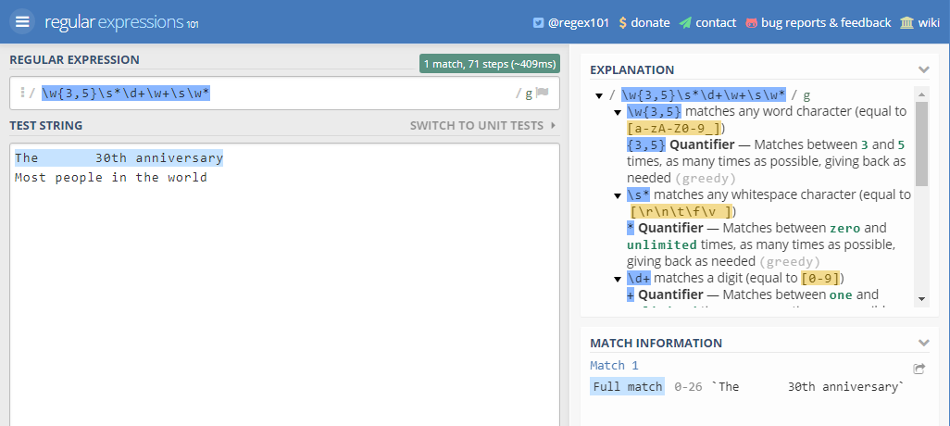
Patterns (playground)
Reference) https://regex101.com/

Slide 12
Programming code

Slide 13
Summary
Phone Number Classifier
Log Classifier
Specific Image File Classifier

Slide 14
1. Phone Number Classifier
Description: Identify whether the given string is a phone number or not.
Given String Format: - -
(Consider that the area code is one of 02, 031, 010, 016, 019 The middle letters must have 3 or 4 letters)
Area Code
?????????
?????????
Input | Output
8 010-1234-4567 0100-44555-12 031-971-8844 4a8-0000-1145 016-345-1324 019-4421-4812 01-44-44 02-124-4835 | Y N Y N Y Y N Y

Slide 15
2. Log Classifier
Description:
Determine if the given string is the requested log in /admin on GET in April 2018.
Input | 3 172.17.0.1 - - [11/Apr/2018] “POST /login HTTP/1.1" 304 0 "-" "Mozilla/5.0 (Macintosh; Intel Mac OS X 10_13_3) AppleWebKit/537.36 (KHTML, like Gecko) Chrome/65.0.3325.181 Safari/537.36" "-“ 163.152.1.8 - - [25/Apr/2018] “GET /admin HTTP/1.1" 304 0 "-" "Mozilla/5.0 (Macintosh; Intel Mac OS X 10_13_3) AppleWebKit/537.36 (KHTML, like Gecko) Chrome/65.0.3325.181 Safari/537.36" "-“ 182.175.5.1 - - [2/Mar/2017] “GET /main HTTP/1.1" 304 0 "-" "Mozilla/5.0 (Macintosh; Intel Mac OS X 10_13_3) AppleWebKit/537.36 (KHTML, like Gecko) Chrome/65.0.3325.181 Safari/537.36" "-"
Output | N Y N

Slide 16
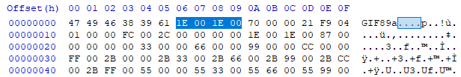
3. Specific Image File Classifier
File format:
GIF file is composed of many chunks
HxD allows you to see the inside of a GIF file(https://mh-nexus.de/en/hxd/)
All gif files have the first three characters 0x47(G), 0x49(I), and 0x46(F)
Offset 06, 07 means Canvas Width, Offset 08, 09 means Canvas Height
Every GIF file has Canvas information on same offset 06~09
Above image has 30 * 30 pixels (0x1E = 30)
You can get file format information from the Internet

Slide 17
3. Specific Image File Classifier
Description: Determine that the given string is the hexadecimal header string of a BMP file whose dimensions are 80 * 70 pixels in width and height
Input | 4 4749463839611E001E0070000021F904010000FC002C000000001E001E008700 00000000330000660000990000CC0000 424D8E9C00000000000036040000280000002C0100008200000001000800000 000005898000000000000000000000000 424D86030000000000003E00000028000000500000004600000001000100000 000004803000000000000000000000000 89504E470D0A1A0A0000000D494844520000040000000300080200000035D88 25A000342D54944415478DAECBD59B05D
Output | N N Y N

Slide 18
3. Specific Image File Classifier
Description: Determine that the given string is the hexadecimal header string of a BMP file whose dimensions are 80 * 70 pixels in width and height
Input | 4 4749463839611E001E0070000021F904010000FC002C000000001E001E008700 00000000330000660000990000CC0000 424D8E9C00000000000036040000280000002C0100008200000001000800000 000005898000000000000000000000000 424D86030000000000003E00000028000000500000004600000001000100000 000004803000000000000000000000000 89504E470D0A1A0A0000000D494844520000040000000300080200000035D88 25A000342D54944415478DAECBD59B05D
Output | N N Y N
Previous GIF image case
No match, Because It is GIF file

